Slide 1
Library Management System of IIT

Slide 2
Project Presentation
Submitted by:
Nahidul Islam (192345)
Mahbubur Rahman (192341)
Md. Shakil Hossain (192340)
Submitted To:
Dr M Mesbahuddin Sarker
Professor
Institute of Information Technology
Jahangirnagar University

Slide 3
Contents
Introduction
- About Digital Library
Related Works
Challenges
Requirement
Project Output Screenshots.
Conclusion
- Future Plan.

Slide 4
Introduction
About Digital Library
A Digital Library is a special library with a focused collection of digital objects that can include text, visual material stored as electronic media formats along with means for organizing, storing, and retrieving the files and media contained in the library collection.

Slide 5
Related Works
Data base connection.
Java GUI Application.
Java swing application.

Slide 6
Challenges
Work with database.
Make a runnable jar File.
Make jar file to exe File.
Working with java GUI and Swing.
Set specific code for different kinds of jbutton, jlabel, jtextfield,jdate,jTable, jpanel etc.

Slide 7
Requirement
Software configuration:
Operating system: Windows 7, 8, 10, 11.
Software: NetBeans 8.2 (front end)
Language: java Runtime Environment
Database: MySQL Database Service
Hardware Configuration:
Processor: Pentium(R) Dual-core CPU to core-i3
Hard Disk: Minimum 4 GB
RAM: 512 MB or more.

Slide 8
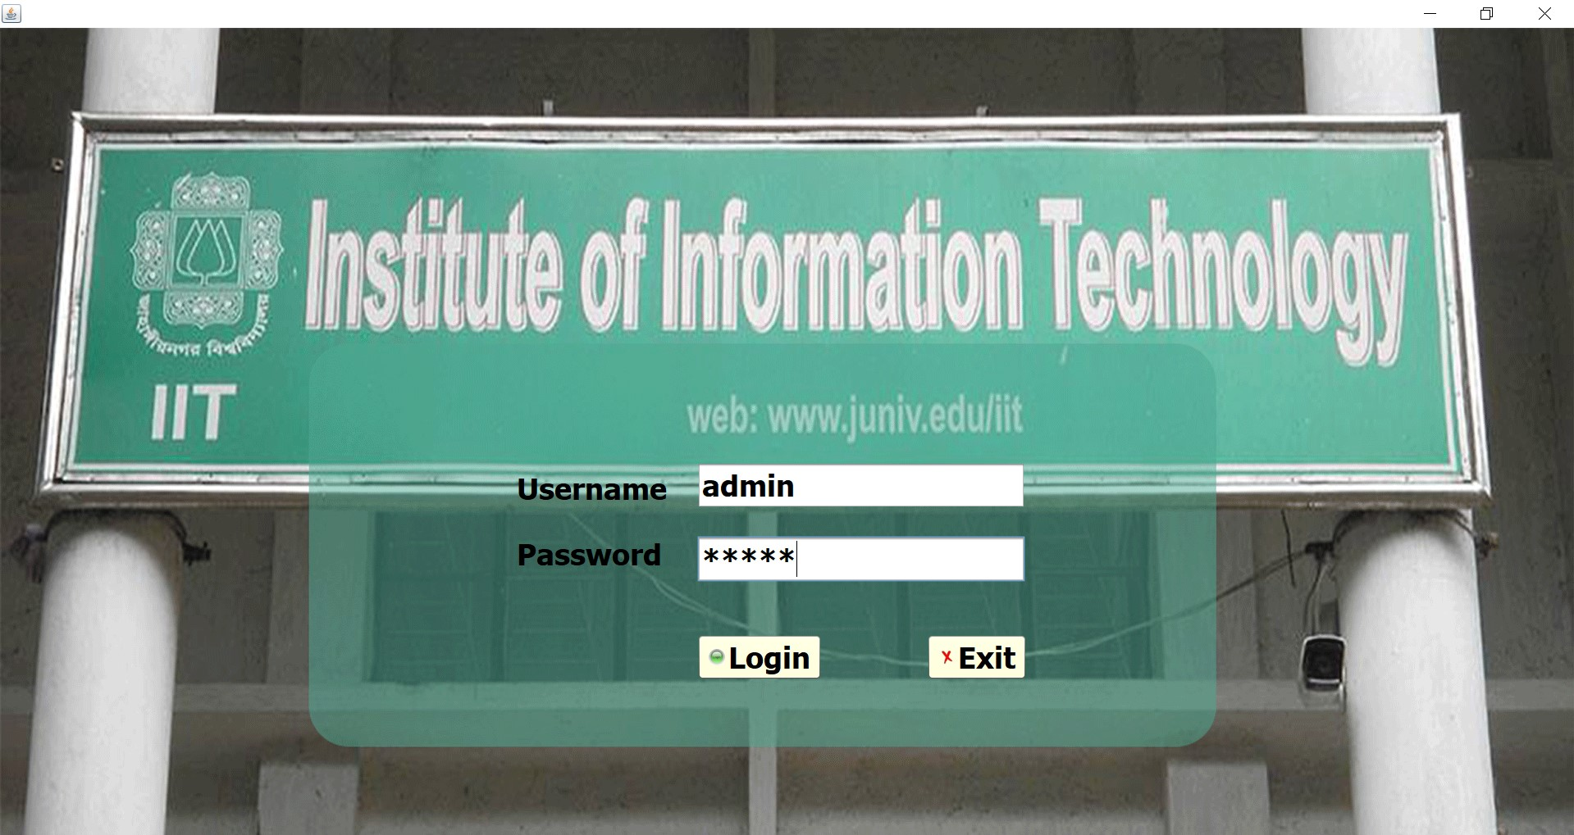
Project Output Screenshots
Login

Slide 9
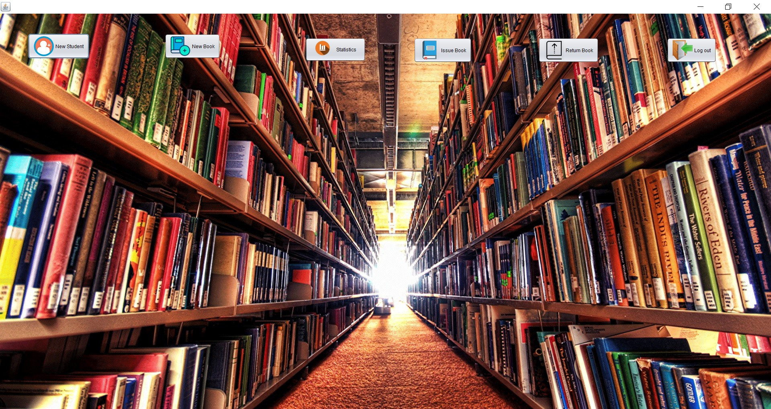
Home

Slide 10
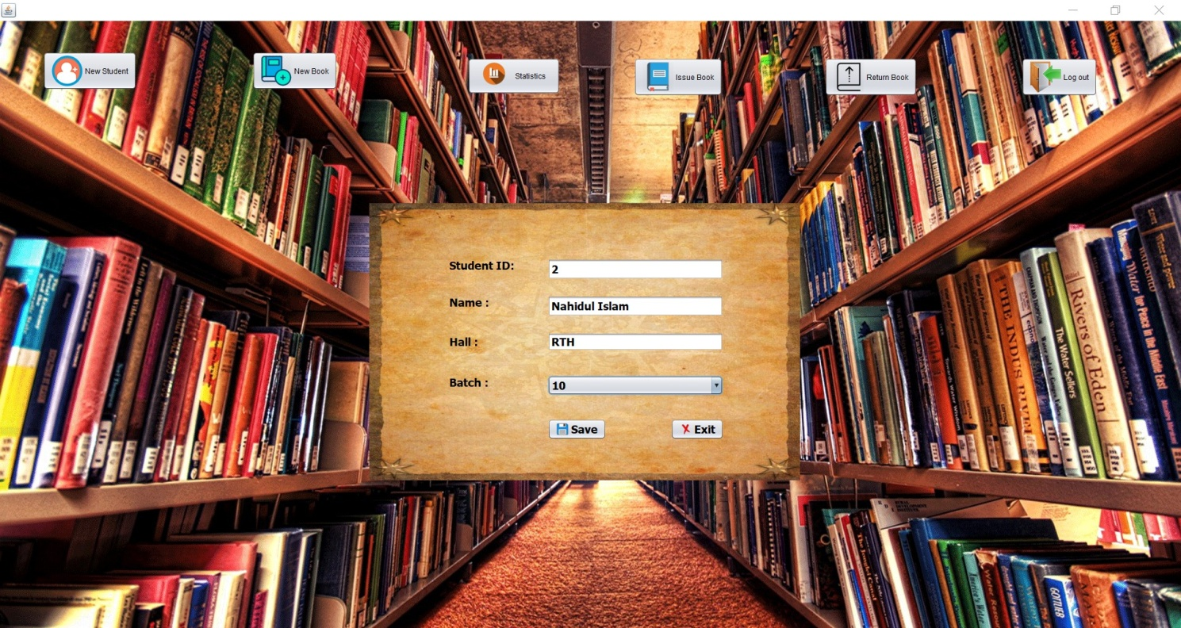
New Student

Slide 11

New Book

Slide 12
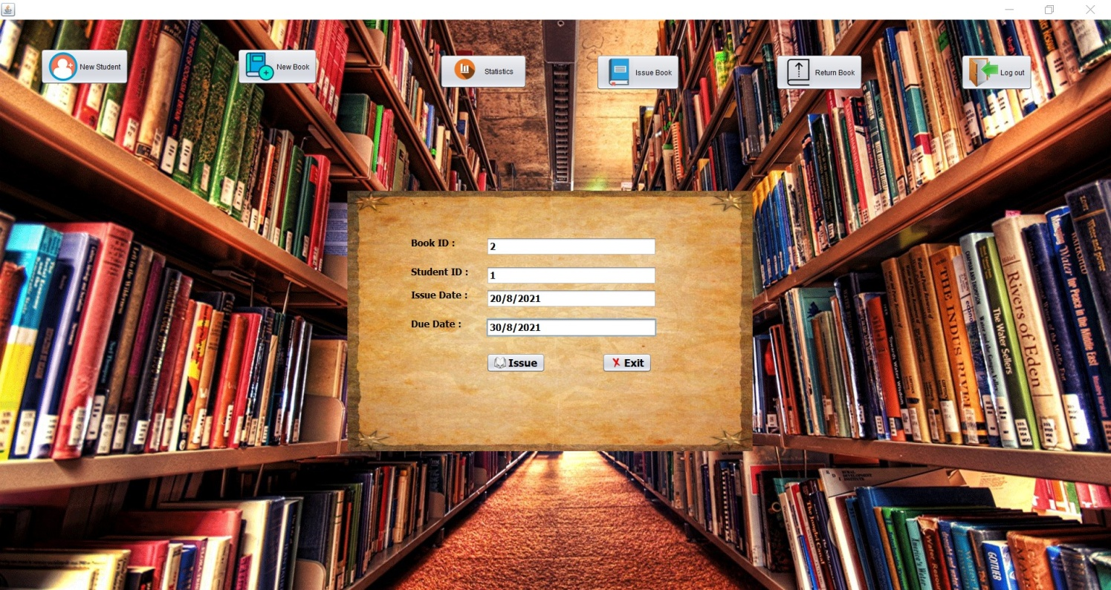
Issue Book

Slide 13

Return Book

Slide 14
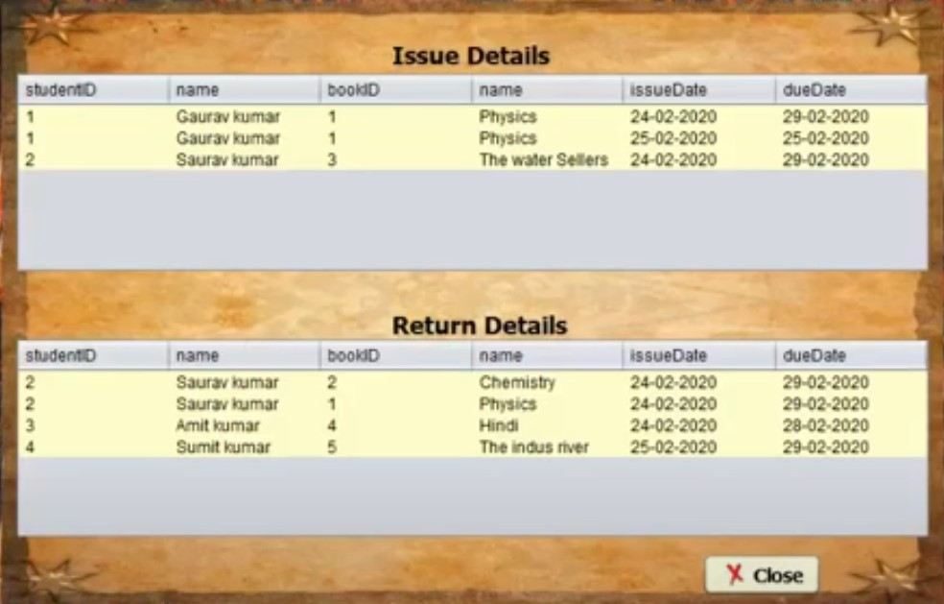
Statistics

Slide 15
Conclusion
Future Plan
Library Mobile App
A-Z list of E-Journals
New Arrivals Alert
Faculty Publications
Special Collection (Government Publication, Children's books etc).

Slide 16
References
https://netbeans.org/downloads/
http://www.oracle.com/technetwork/java/javase/downloads/jdk 8-downloads-2133151.html
https://sourceforge.net/projects/finalangelsanddemons/files/rs2x ml.jar/download
http://www.java2s.com/Code/Jar/j/Downloadjcalendar14jar.html
https://www.mysql.com/downloads/

Slide 17
Thank You

